Slide 1
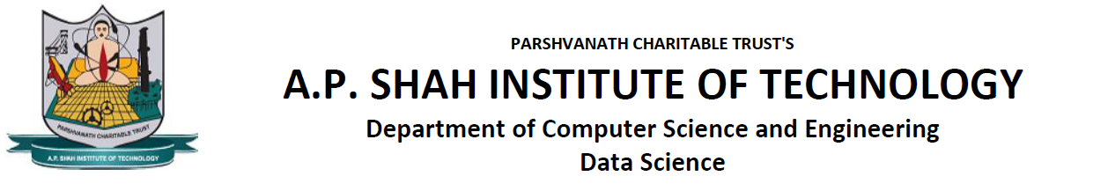
APSIT CANTEEN MANAGEMENT SYSTEM
Presented by :-
21107050 Sahil Mujumdar
21107029 Ayush Mistry
21107028 Tanvi Mirgal
21107054 Urvi Padelkar
Project Guide
Prof. Rajashri Chaudhari

Slide 2
Contents
Introduction
Objectives
Scope
Features / Functionality
Project Outcomes
Technology Stack
Block Diagram

Slide 3
1. Introduction
A canteen facility is a system that is provided by organizations for their employees/students.
Canteen management system is to provide fast services to their college students, Staffs etc.
Organizations with large numbers of employees cannot handle a canteen with manual processes.

Slide 4
Problem Definition:
Traditional method of students standing in queue
Time consuming
Burden on canteen staff
Solution:
Avoids spending time waiting in the queue
Fast and efficient service
Reduces Manual work

Slide 5
2. Objectives
To manage the details of Canteen ,sells, Product ,Meal
To manage the information about canteen, Meal type , Meal
Only the Administrator is guaranteed the access
To reduce the manual work for managing the Canteen , Meal type, Sells
To track all the details about the Sells, Product , Meal

Slide 6
3. Scope
The scope of the business rules document is the online system including the management of finances, management of employee scheduling, and the
customer online ordering system.

Slide 7
4. Feature /Functionality
Customizable Menu
Helpful in saving time and doing more than one work at a time. Allows
Administrator to create different menu items with full accuracy. creation
and addition of different items can be done at a time.
Cashless Transactions
Allows cashless transactions offers cashless cafeteria processing.
Consumption Status
It takes no extra time in displaying the details and also keeps a track of food
expenses.

Slide 8
5. Outcome of Project
Login/sign up
Forgot password
Visit Categories of food
View, edit or deleted the selected items
Place order
View bill details

Slide 9
6. Technology Stack
FRONT END: jdk (JAVA) 18.0.2.0 , Netbeans 14
BACK END: MySQL 8.0.31.0

Slide 10
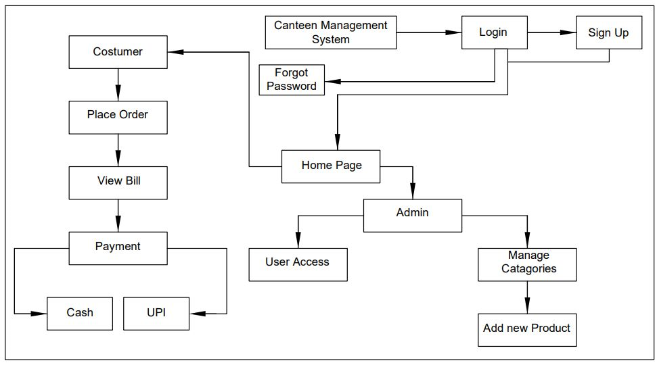
7. Block Diagram

Slide 11
8.CONCLUSION
The Canteen Management Software is designed to help you overcome a variety of challenges encountered in running a canteen. Our system is designed in such a manner that canteen management works are carried with an ease as it is subjected in very organized manner .

Slide 12
Thank You...!!

